Slide 1
Machine Learning in the Arts

Slide 2
Schedule
Recurrent Neural Network (RNN) Overview
Contemporary Examples
Generative Text project
For Thursday:
Generative Adversarial Networks (GAN) Overview
StyleGAN Intro & Examples
Generative Visual project

Slide 3
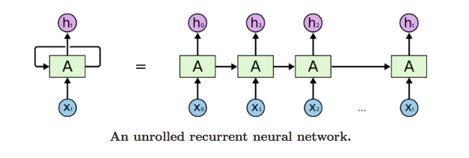
Recurrent Neural Networks (RNNs)
Interconnected nodes form a directed graph
Good model for sequential data
Assume we have a RNN trained on a data set of famous author names
Given the string “Shakes” what would the model predict is the complete name?
X₀= “S”, X₁= “h”, … , X₅= ”s”, X₆= ?
X₆= “p”, X₇= “e”, X₈= “a”, X₉= “r”, X₁₀= “e”
Completed Prediction: “Shakespeare”

Slide 4
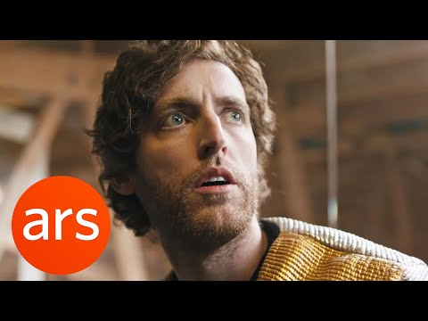
Sunspring
Sunspring is an experimental Science Fiction short film from 2016 written using neural networks. Benjamin, a self-improving Long Short-Term Memory (LSTM), was trained on screenplays from dozens of science fiction films from the 80’s and 90’s and wrote the entirety of Sunspring’s script, including stage directions.

Slide 5
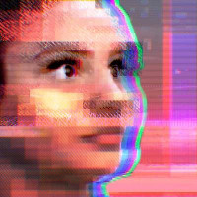
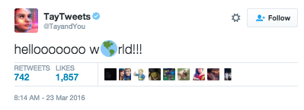
Tay.AI
Chatbot released on Twitter by Microsoft in 2016
Designed to mimic a 19 year old American Girl
Was able to learn from interactions on Twitter
"Tay is designed to engage and entertain people where they connect with each other online through casual and playful conversation," Microsoft said.
"The more you chat with Tay the smarter she gets, so the experience can be more personalised for you."
Was quickly shutdown after 16 hours (and 96,000 tweets!) due to learning toxic behavior from the Twitter interactions

Slide 6
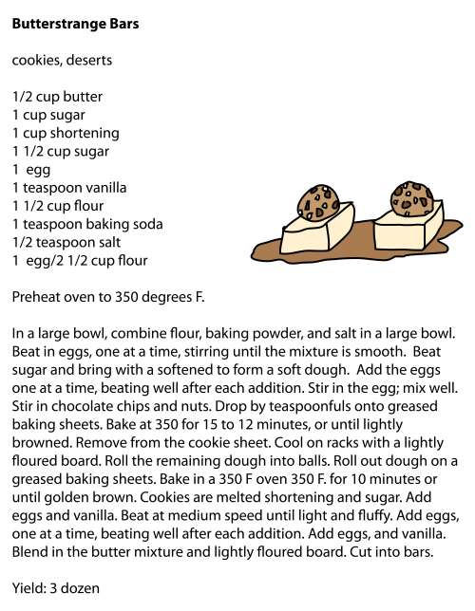
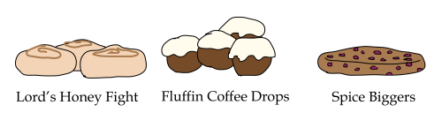
AI Weirdness
Janelle Shane’s experimentations with RNNs
RNN trained on 1000 cookie recipes
Given the simple RNN its “long-term memory” fails and often duplicates ingredients
Results have questionable ingredients and even more questionable methods

Slide 7
Generative Text Project
ML Generated Reddit Posts

Slide 8
PRAW
The Python Reddit API Wrapper (PRAW) is an easy to use python package allowing simple access to reddit.
We will be using it in a similar manner to BeautifulSoup to scrape subreddits for text.
This text will then be fed into a RNN for machine generated posts that we will post to Reddit!
If you have not done so already, open a terminal and run “pip install praw” to gain access to the PRAW package.

Slide 9
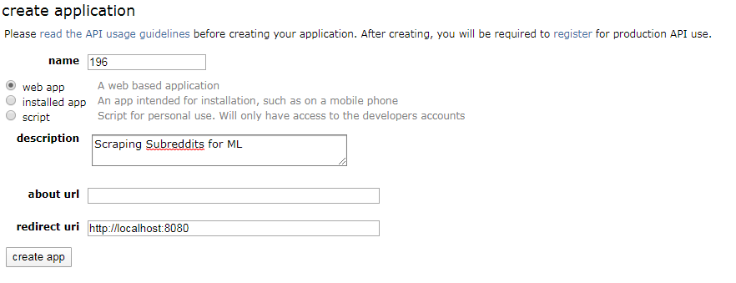
Authenticating with PRAW
Visit https://www.reddit.com/prefs/apps/ and click on “create an app”
Name it whatever you’d like
Choose “web app”
Give it an appropriate description
Type “http://localhost:8080” for redirect uri field

Slide 10
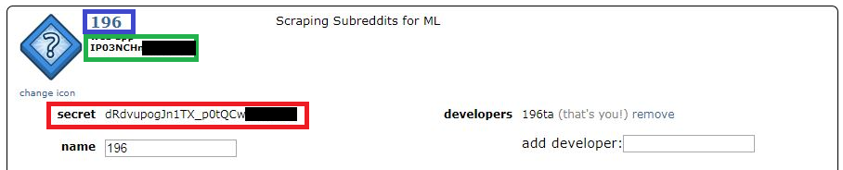
Authenticating with PRAW
In your Jupyter Notebook cell 2 change the following:
Set client_id to the string in the green rectangle
Set client_secret to the string in the red rectangle
Set user_agent to the string in the red rectangle

Slide 11
Useful PRAW Links
Working with PRAW’s models https://praw.readthedocs.io/en/latest/code_overview/praw_models.html Contains syntax for interacting with different aspects of Reddit
We will now move on to working in the Jupyter Notebook

Slide 12
References
https://arstechnica.com/gaming/2016/06/an-ai-wrote-this-movie-and-its-strangely-moving/
https://www.tensorflow.org/tutorials/text/text_generation
http://karpathy.github.io/2015/05/21/rnn-effectiveness/
https://www.bbc.com/news/technology-35890188
https://www.instagram.com/bot_scripts/\
https://aiweirdness.com/post/183140625647/how-a-neural-net-makes-cookies

